Slide 1
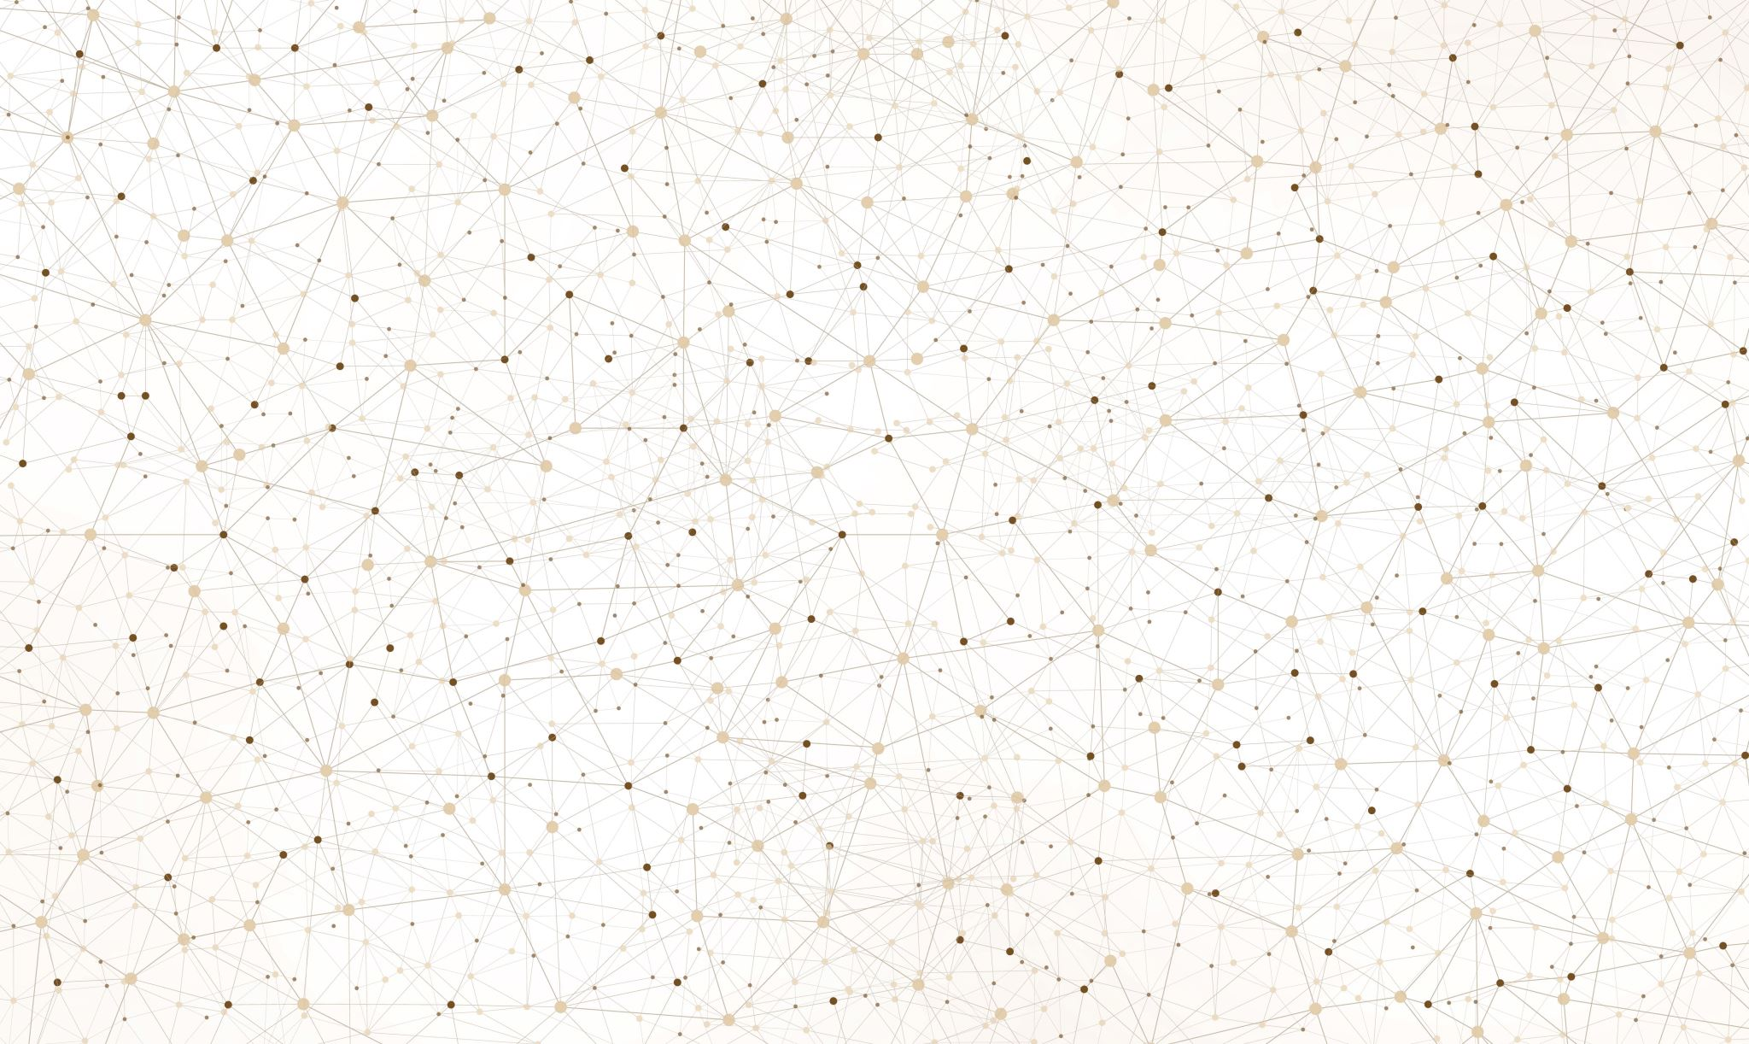
Week 13
Espruino Tools

Slide 2
Progress
Testing
Testing has been added to ‘core’, ‘uart’ & ‘create-espruino-app’ repos, has not been added to peer as I would be testing somebody elses package, this can be changed in the future.
Package Versioning
Husky has been added to all package repos, now a commit will require, ‘fix’ for 0.0.X change, ‘feat’ for 0.X.0 change and ‘maj’ for X.0.0. This will auto increment the version and in the future has the option of running pre-commit commands, currently only package versioning is done.
Demos
Whilst adding the Puck demo a few problems appeared, the core package does not work with setInterval very well, this is something that will be fixed with the transpiler but I did not see a point in wasting my time with this issue.

Slide 3
Progress(cont.)
UART
Began UART overhaul, this will be continued in the next semester.

Slide 4
Extras
Demos
the demo site could have a page designed to output a correctly formatted README.md file, by replicating the current demo page but will input boxes, allowing for users to add the youtube link and github links, this will also sort the issue of the github link not working and will also allow for a structure to be created to have extra links
<!–- SIDEBAR LINKS
{
“github” : “http://githublink”,
“other link”: ”http://otherlink”
}
SIDEBAR LINKS -->
<!-- VIDEO LINK {“link”:”http://youtubelink”} VIDEO LINK -->
This method will also change how the video description and project description work as well. Using <!—VIDEODESC --> and <!– PROJDESC -->

Slide 5
Issues
The core miniParser does not work as expected.

Slide 6
Decisions Made
Using Husky
Changing Demo structure

Slide 7
What Next?
What am I doing next semester
Create Transpiler
Overhauling core to use transpiler.
Create online IDE
Complete UART overhaul. Resolve any issues with current package (delays), update to use classes or even more current JS.
Populate Dissertation
Produce all demos

